Slide 1
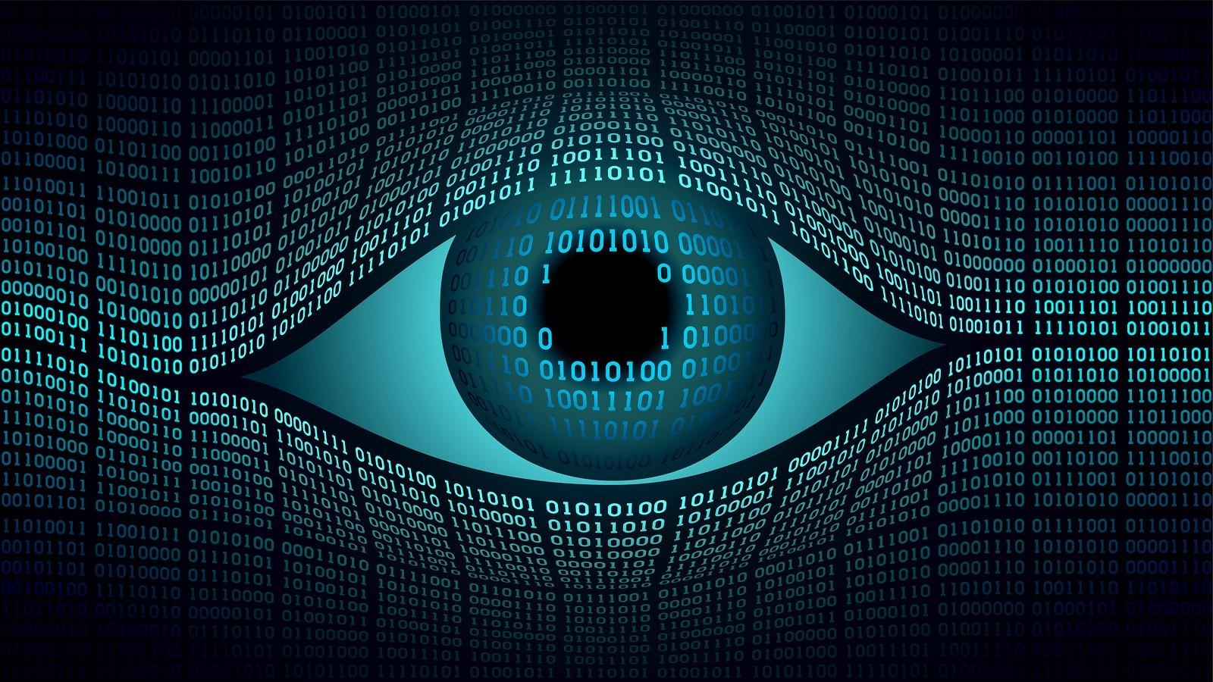
Computer Vision
Notes:
Fletch

Slide 2
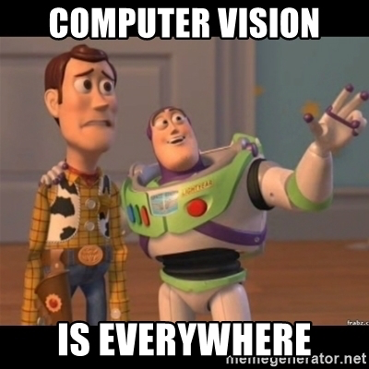
Notes:
Fletch

Slide 3
What is it?
The field of Computer Science that deals with understanding visual elements such as images or videos.
Seeks to perform tasks humans can accomplish visually
Notes:
Fletch

Slide 4
Tasks like …
Object classification
Face recognition
Motion Capture
3D scene reconstruction
Image Segmentation
Background/Foreground Detection
Notes:
Olly

Slide 5
Tasks like …
Object classification
Face recognition
Motion Capture
3D scene reconstruction
Image Segmentation
Background/Foreground Detection

Slide 6
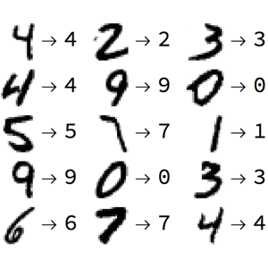
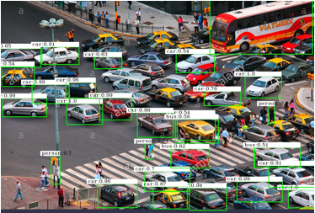
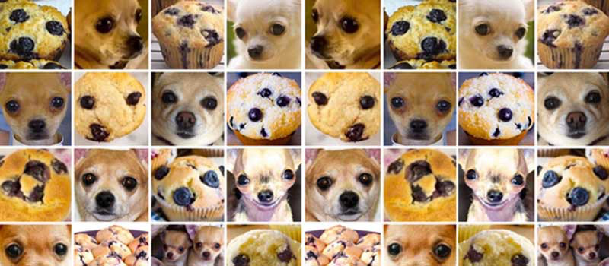
Notes:
Olly

Slide 7
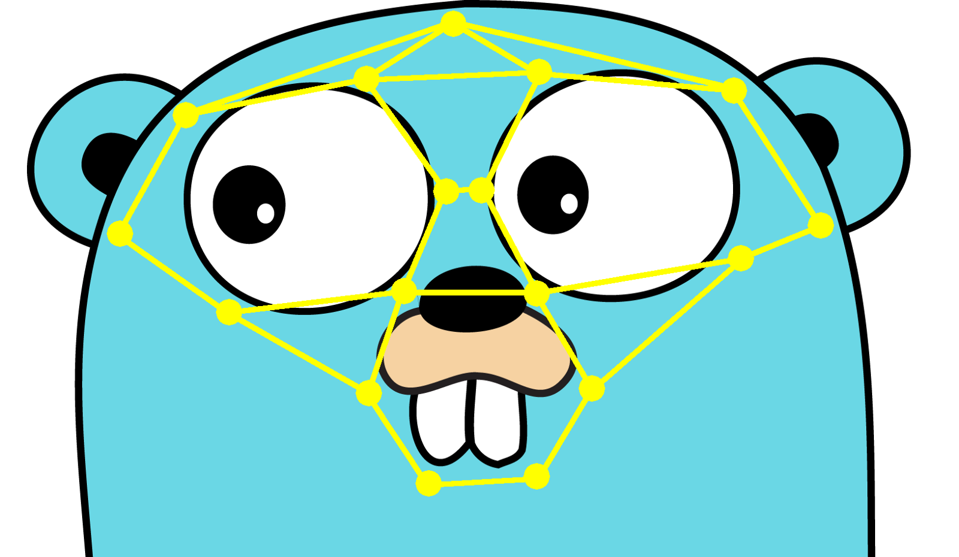
Tasks like …
Object classification
Face recognition
Motion Capture
3D scene reconstruction
Image Segmentation
Background/Foreground Detection
Notes:
Fletch

Slide 8
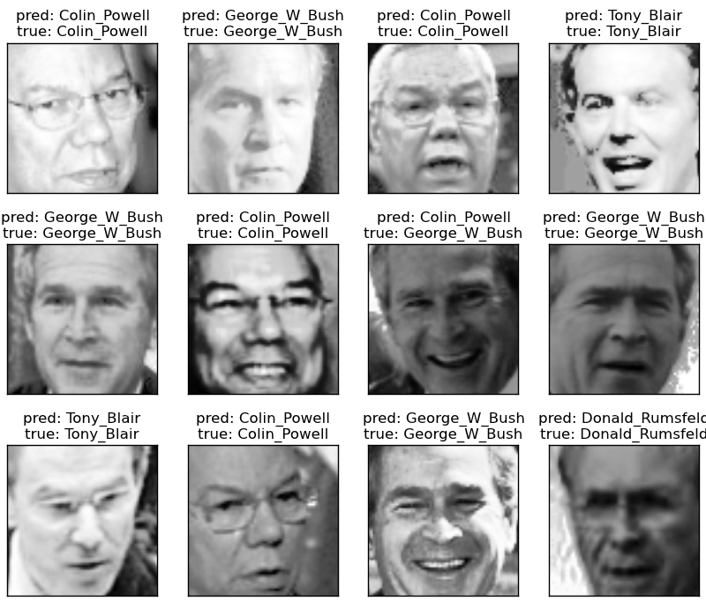
Notes:
Fletch

Slide 9
Tasks like …
Object classification
Face recognition
Motion Capture
3D scene reconstruction
Image Segmentation
Background/Foreground Detection
Notes:
Olly

Slide 10
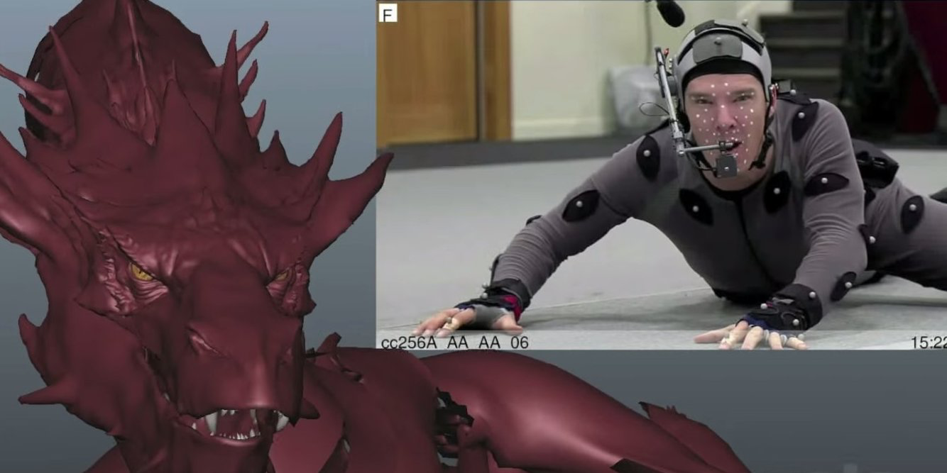
Notes:
Olly

Slide 11
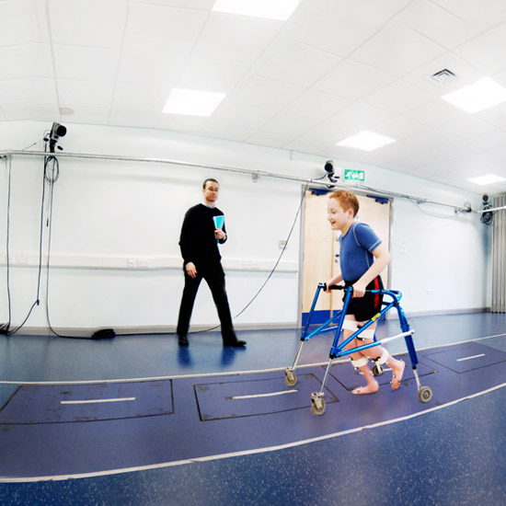
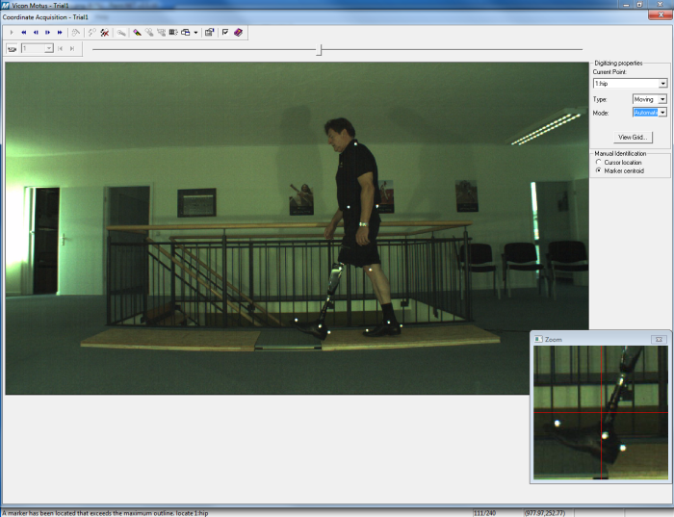
Notes:
Olly

Slide 12
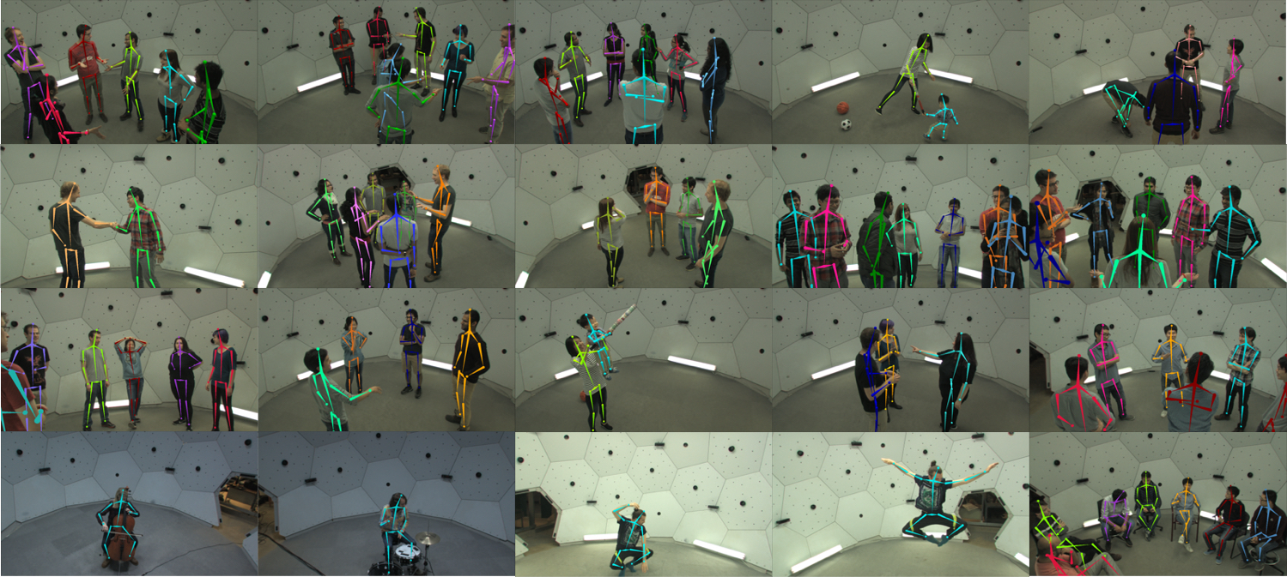
Notes:
Olly

Slide 13
Tasks like …
Object classification
Face recognition
Motion Capture
3D scene reconstruction
Image Segmentation
Background/Foreground Detection
Notes:
Fletch

Slide 14
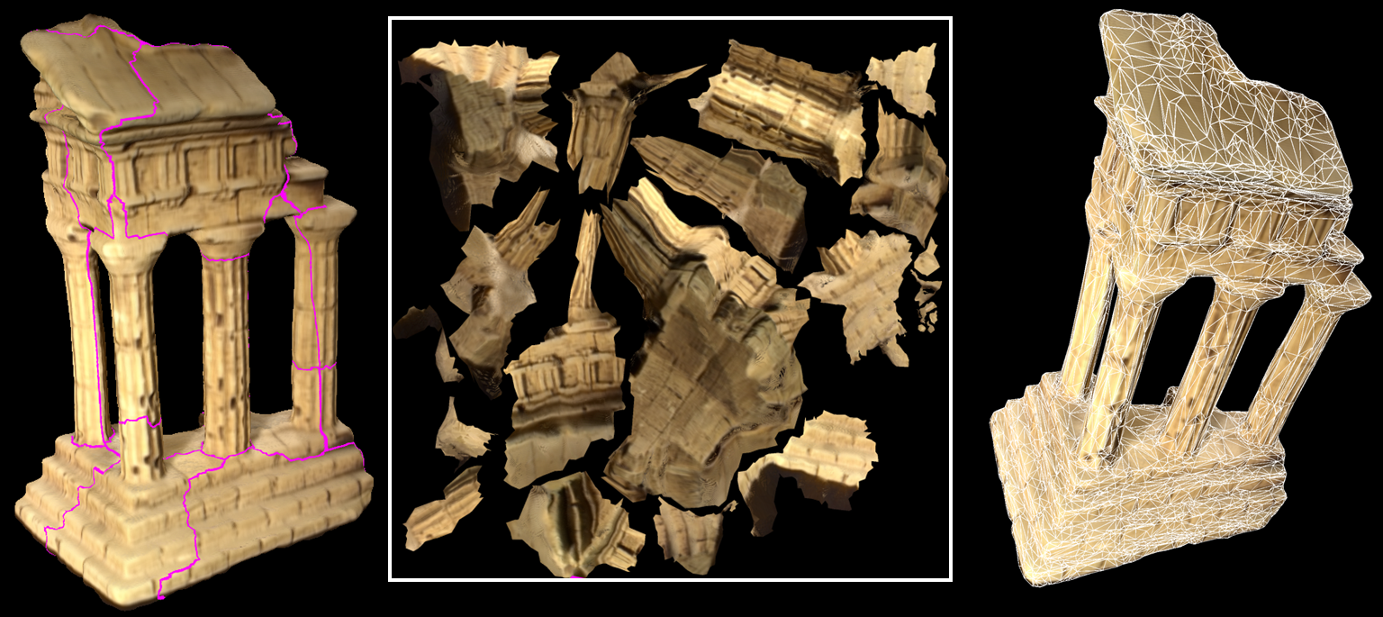
Notes:
Fletch

Slide 15
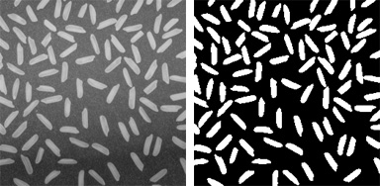
Tasks like …
Object classification
Face recognition
Motion Capture
3D scene reconstruction
Image Segmentation
Background/Foreground Detection
Notes:
Olly

Slide 16
Tasks like …
Object classification
Face recognition
Motion Capture
3D scene reconstruction
Image Segmentation
Background/Foreground Detection
Notes:
Fletch

Slide 17
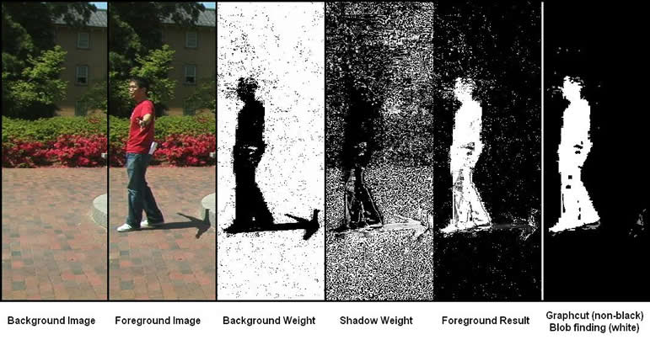
Notes:
Fletch

Slide 18
Background/Foreground
Detection

Slide 19
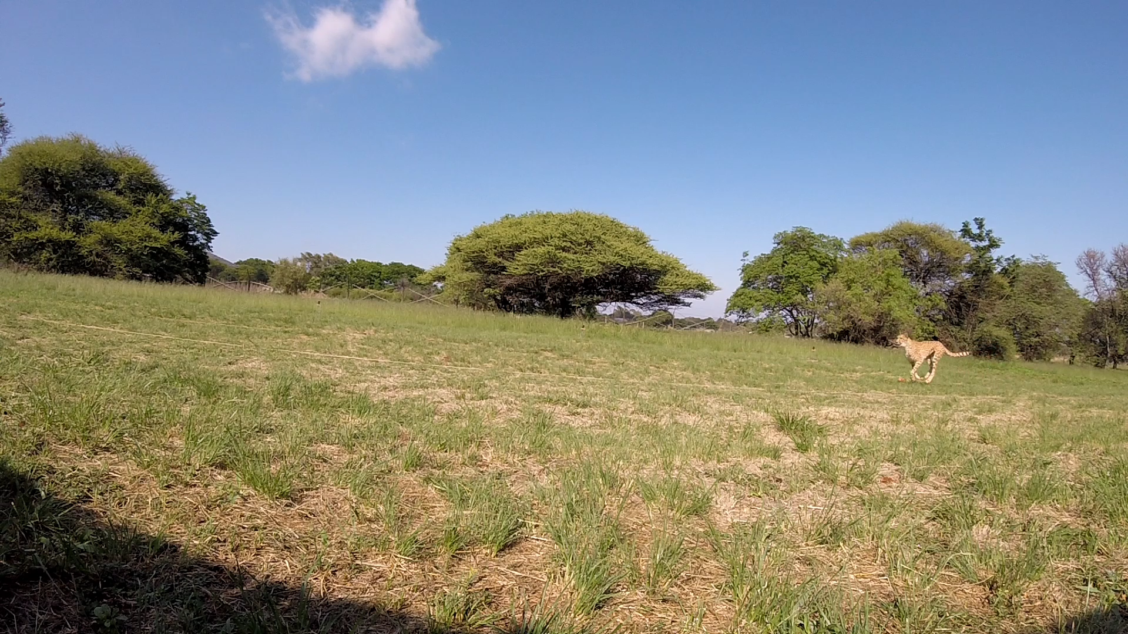

Slide 20


Slide 21
But wait!
How are these videos and images even represented in computers?
Well, ever heard someone or yourself say “gosh this pic is so pixelated”!
Yep, it’s done using pixels

Slide 22


Slide 23
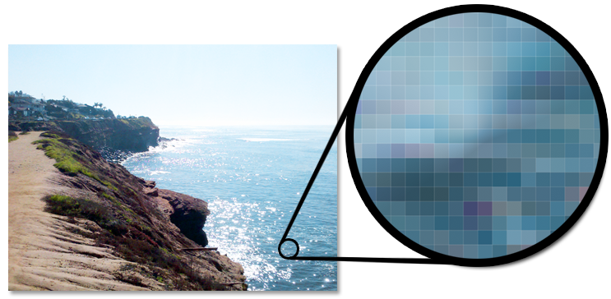

Slide 24
All those 2D list free response questions,
we teach them for a reason!

Slide 25
Back to background/foreground stuff
Any ideas?

Slide 26
(inefficient) Code
def getBackground(imgList, rows, cols):
bg = [[0]*cols for i in range(rows)]
for row in range(rows):
for col in range(cols):
for img in imgList:
bg[row][col] += img[row][col]
return bg
#divide by number of imgs

Slide 27
RGB vs. Grayscale
RGB: Red, Blue, Green components in range (0-255)
(0, 0, 0) -> Black
(255, 255, 255) -> White
Grayscale: Just gray level
0 to 255 (Black -> White)

Slide 28
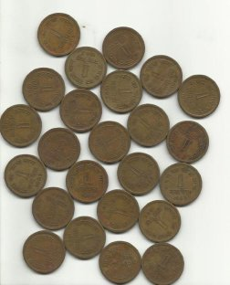

Slide 29
(show basic openCV image reading/conversion)

Slide 30
Image Segmentation
Literally, just partitioning an image into multiple segments based on your needs

Slide 32
(Do openCV morphology coding examples)

Slide 33
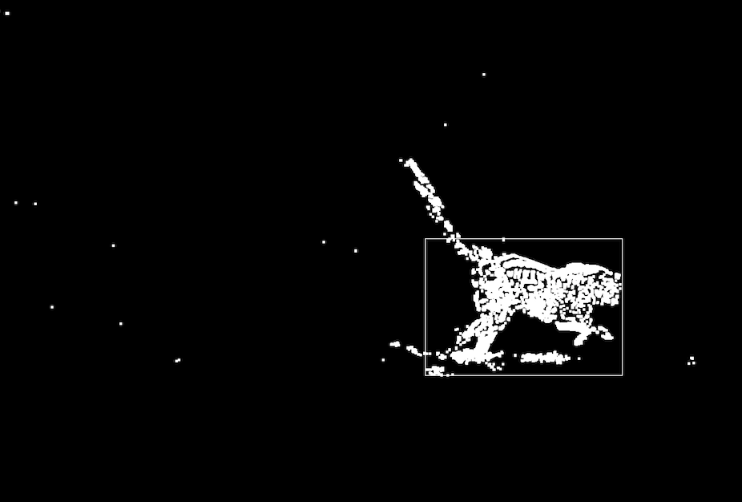

Slide 34
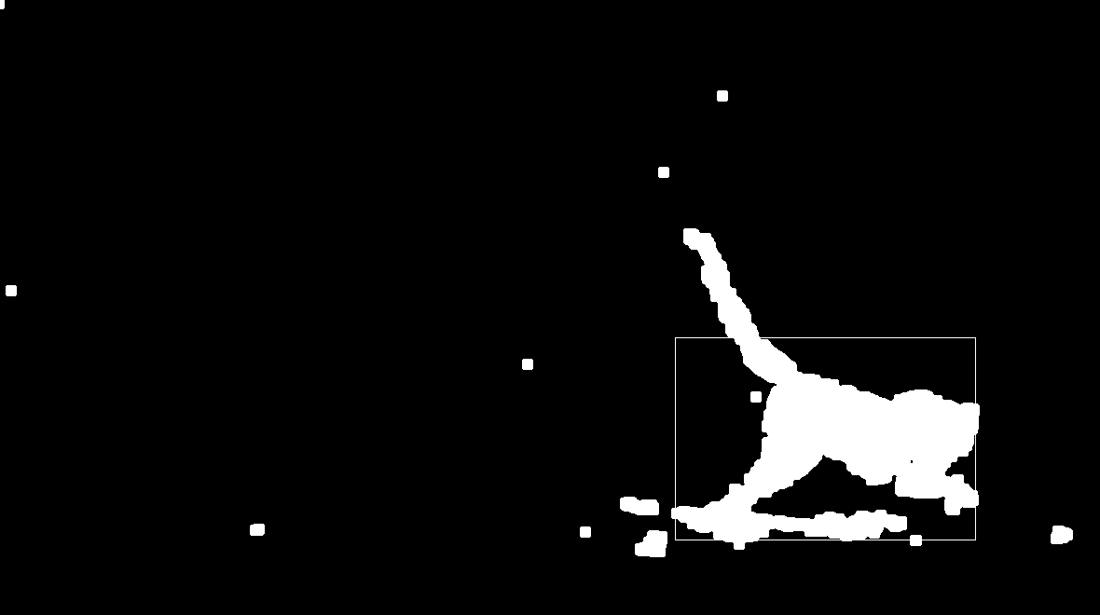

Slide 35
Any questions, yo?

Slide 36
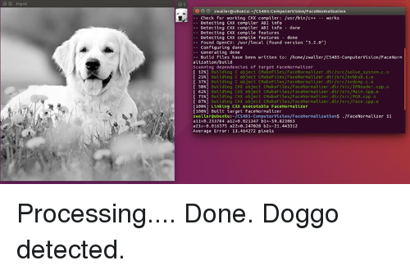

Slide 37
Aight bye fam <3

